Slide 1

Secure Backend Analysis
Detailed Teardown of app.py and secure_auth.py Modules

Slide 2
Module 1: app.py
The API Gateway & Request Handling Layer

Slide 3

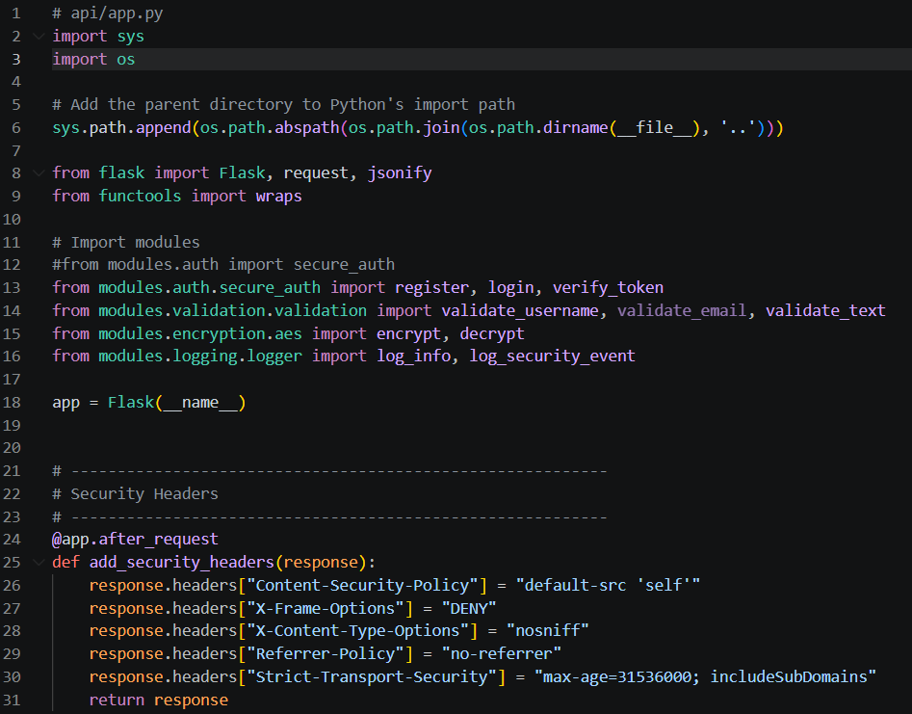

REQUEST HARDENING
Implementation of the add_security_headers middleware to enforce browser-side security policies.
Content-Security-Policy
X-Frame-Options: DENY
HSTS (Strict-Transport-Security)

Slide 4
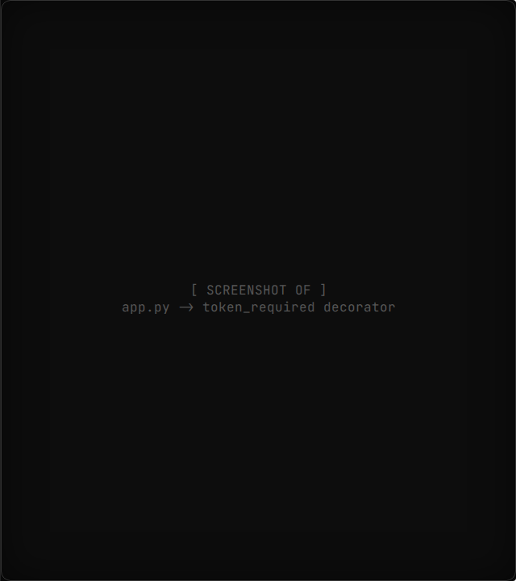
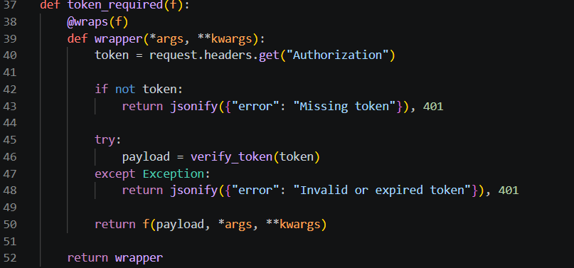


ACCESS CONTROL
Utilizing the token_required decorator for route-level protection.
Enforces "Authorization" header presence and validates via verify_token().

Slide 5





API ROUTES OVERVIEW
/encrypt
/register
/login
AES encryption endpoint for sensitive text payloads.
POST method with username/email validation before hashing.
Issues JWT upon AuthResult success. Tracks logs for security audits.

Slide 6
Module 2: secure_auth.py
Core Authentication & Identity Management

Slide 7
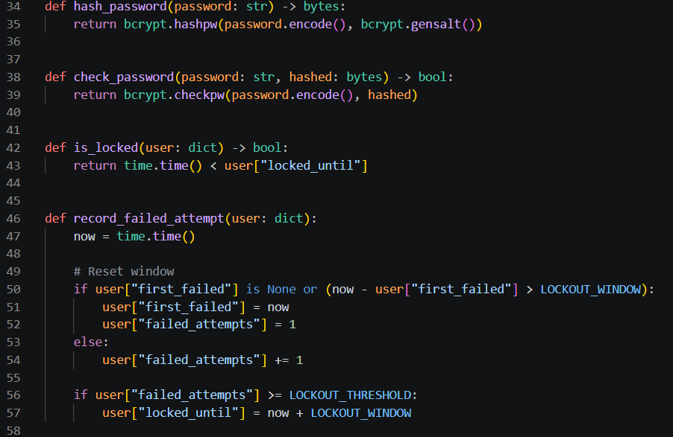
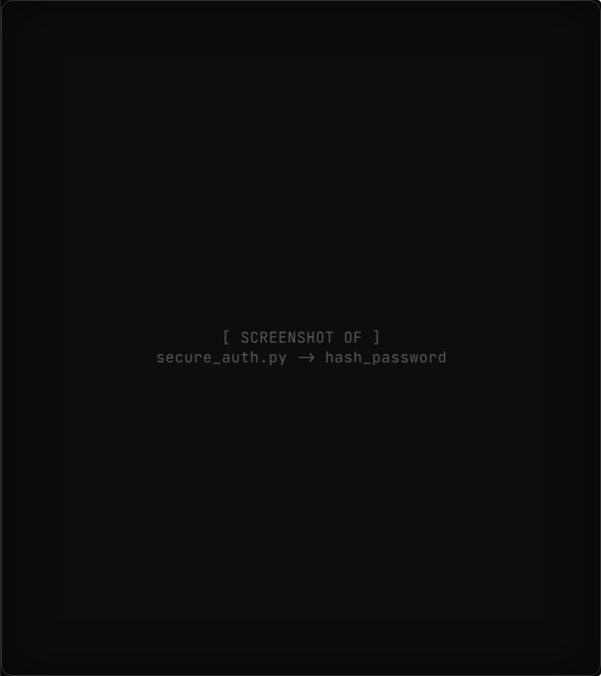

SALTED HASHING
Implementation of bcrypt.hashpw ensures passwords are never stored in plain text.
Logic Applied:
1. Encode to UTF-8 2. Generate Salt 3. Compute Expensive Hash

Slide 8
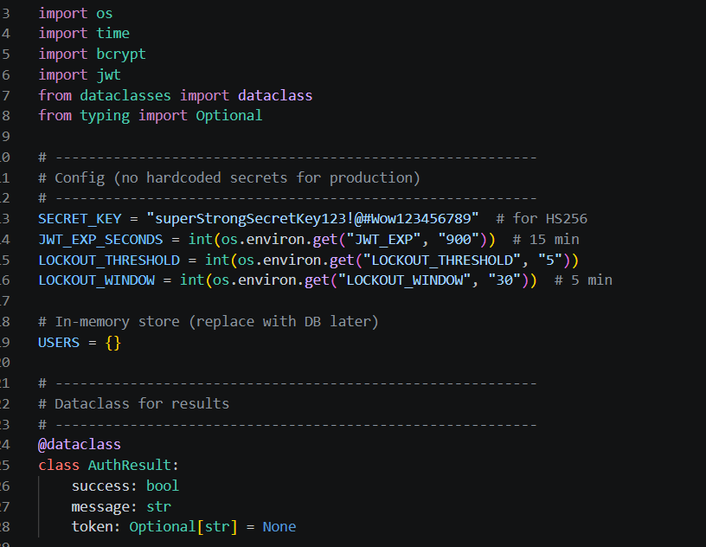
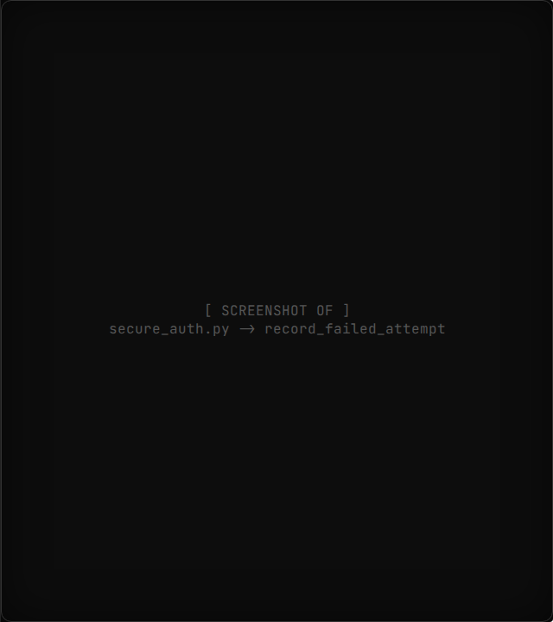


BRUTE FORCE MITIGATION
Using LOCKOUT_THRESHOLD and LOCKOUT_WINDOW to prevent credential stuffing.
Current Configuration:
Threshold: 5 attempts Window: 30 minutes

Slide 9
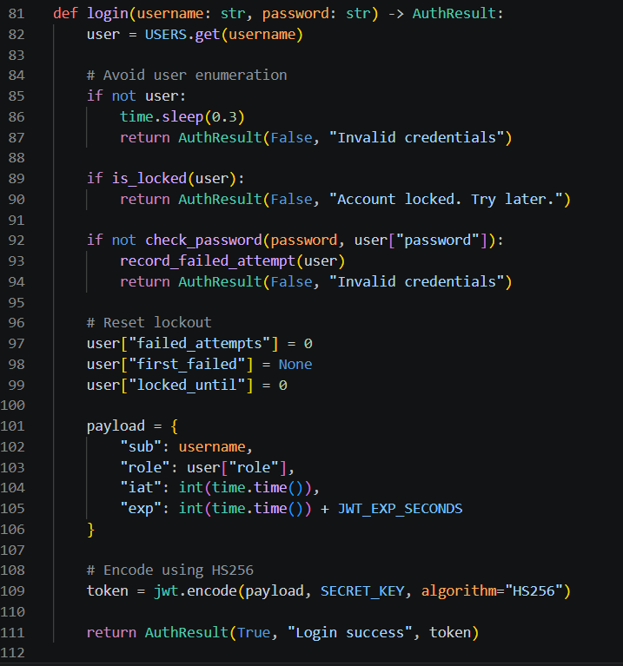
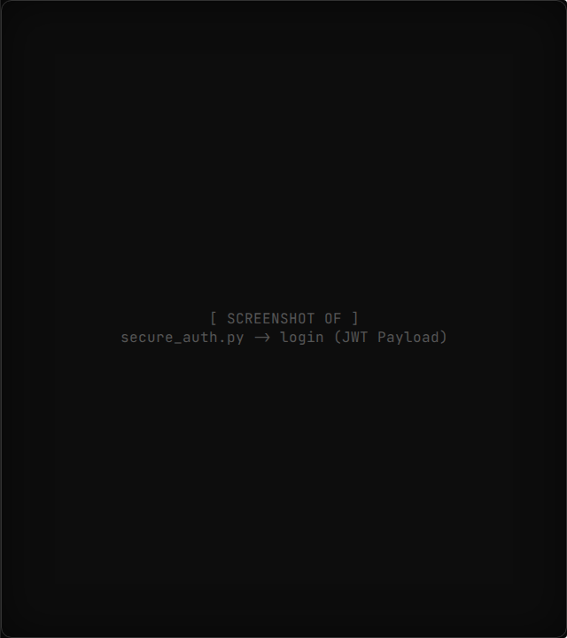

TOKEN ISSUANCE
Inside the login function, the JWT payload is structured with 'sub', 'role', 'iat', and 'exp'.
"HS256 Algorithm used for signing."

Slide 10
SECURITY CONTROL MATRIX
Security Domain | Function/Variable | Objective
Integrity | SECRET_KEY | Cryptographic signing of tokens
Availability | is_locked() | Prevents service exhaustion by bots
Confidentiality | AES.encrypt() | Protects PII in transit/rest
Non-repudiation | log_security_event() | Audit trail for login actions

Slide 11
FUTURE HARDENING
Short Term
Mid Term
Long Term
Transition from USERS dict to PostgreSQL with persistent salt storage.
Integration of Refresh Token rotation to reduce Access Token lifespan.
Vault-based Key Management (KMS) for AES and JWT Secrets.

Slide 12

Thank You
Code Architecture Review: Complete
Presented By:
Belal Elshazly 221007975
Omar Waleed 221017650

